Slide 1

Support Vector Machines
BT3041
Analysis and Interpretation of Biological Data

Slide 2
Introductory concepts
Please watch the video below to get the basic concepts
SVM – fun and easy machine learning
https://www.youtube.com/watch?v=Y6RRHw9uN9o
In this lecture we will get into the underlying math…

Slide 3
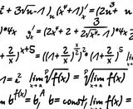
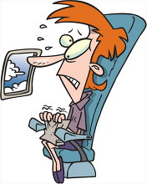
Fasten your seatbelts!!!

Slide 4
What is best Hyperplane or the Decision surface?
Assume linearly separable data
Satish Kumar, Neural Networks – A classroom Approach, McGraw-Hill.

Slide 5
Defining Margin
Let |d₊| = |d₋|

Slide 6
Original Classification criterion
But this condition is somewhat weak.
It allows the decision surface to be infinitesimally close
to some of the data points
Let us have a tighter condition

Slide 7
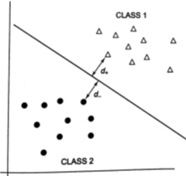

Slide 13
Total Margin (M)
Find W that maximizes the margin, M
Maximizing M ➔ minimizing ||W|| ➔ minimizing ||w||²

Slide 17
Kuhn-Tucker conditions

Slide 19
Note that in this formulation there are no
weight parameters: W and w₀
Use standard quadratic optimization packages to solve for Λ

Slide 20
Calculating W

Slide 21
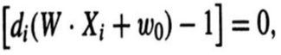
Calculating w₀
(for support vectors)

Slide 22
Testing
An unknown data point, X, can now be classified as:

Slide 23
Nonlinear SVM
Project the input vectors to a higher dimensional space using a nonlinear transformation
X ➔ Z = ϕ(X)
X may be linearly non-separable
But Z may be linearly separable
ϕ(X) is called a Kernel Function. Many kernels are used:
Polynomial
Gaussian etc

Slide 24

Example: the XOR problem
In the feature (hidden layer) space:
When mapped into the feature space < ϕ₁ , ϕ₂ > (hidden layer), C1 and C2 become linearly separable. So a linear classifier with ϕ₁(x) and ϕ₂(x) as inputs can be used to solve the XOR problem.
φ₂
(0,0)
Decision boundary
1.0
0.5
(1,1)
0.5
1.0
φ₁
(0,1) and (1,0)

Slide 25
SVM example

Slide 26
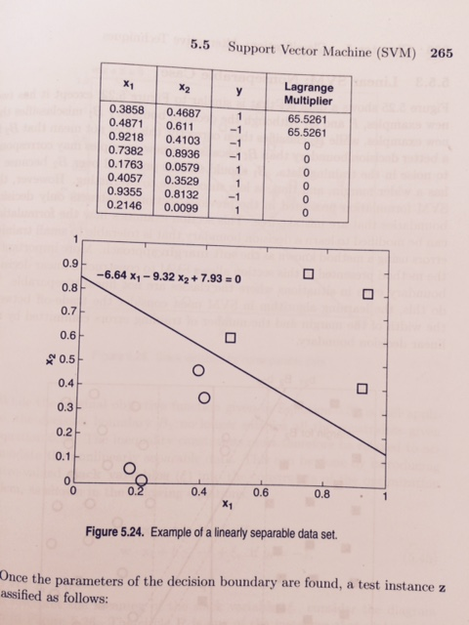
Example #1

Slide 27
To calculate b, invoke,
Nearly the same
w1 = -6.64; w2 = -9.32; b = 7.9

Slide 28
Application of svm in medicine

Slide 29
SVM for diagnosis of diabetes
Yu, W., Liu, T., Valdez, R., Gwinn, M., & Khoury, M. J. (2010). Application of support vector machine modeling for prediction of common diseases: the case of diabetes and pre-diabetes. BMC medical informatics and decision making, 10(1), 16.

Slide 30
Data Source
1999-2004 data set from the National Health and Nutrition Examination Survey (NHANES), USA
Age > 20
Non-pregnant

Slide 31
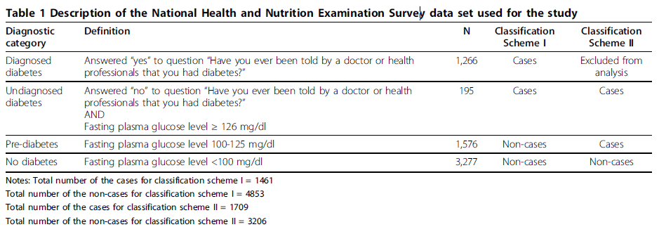
CLASS DEFINITION

Slide 32
Features
14 features: family history, age, gender, race and ethnicity, weight, height, waist circumference, BMI, hypertension, physical activity, smoking, alcohol use, education, and household income.

Slide 33
Two Classification Schemes
Classification Scheme I:
the group of persons with diabetes (diagnosed or undiagnosed) was distinguished from those without diabetes, including persons with pre-diabetes.
Classification Scheme II:
the group of persons with either undiagnosed diabetes or pre-diabetes was distinguished from those without diabetes.

Slide 34
Results: best variables
In Classification Scheme I:
diagnosed or undiagnosed diabetes vs. no diabetes or pre-diabetes
8 variables– family history, age, race and ethnicity, weight, height, waist circumference, BMI, and hypertension–yielded the best performance.
In Classification Scheme II:
undiagnosed diabetes or pre-diabetes vs. no diabetes,
10 variables–family history, age, race and ethnicity, weight, height, waist circumference, BMI, hypertension, sex, and physical activity–performed best.

Slide 35
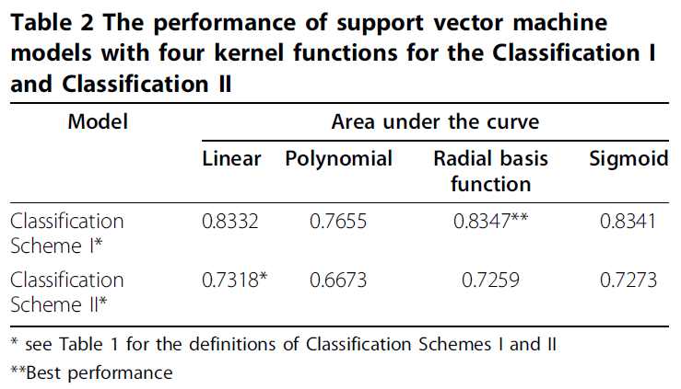
Results: Kernel

Slide 36
Comparison results (SVM)
Proposed SVM model:
Accuracy for detection of:
diagnosed or undiagnosed diabetes = 83.47%,
pre-diabetes or undiagnosed diabetes = 73.18%
Study from Keikes et al.:
Accuracy for detection of:
undiagnosed diabetes were 82.19% (5-fold cross-validation)
pre-diabetes or undiagnosed diabetes = 75.03% (training data set)

Slide 37


